Slide 1
2024-2025 Budget Workshop #4
March 25,2024
Board of Education Meeting

Slide 2
2024-25 Budget Workshop #4
GOAL
PROVIDE BUSINESS
DIRECTION THROUGH
TRANSPARENCY AND DETAIL.
NOTE: Number projections are fluid

Slide 3
2024-25 Budget Workshop #4
Updated Tax Levy & Tax Cap
Tax impact – house assessment
Final Review of 2024-2025 Budget
Administrative / Program / Capital
Revenue Update
Fund Balance Projection Update

Slide 4
2024-25 Budget Workshop #4
Updated Tax Levy & Tax Cap

Slide 5
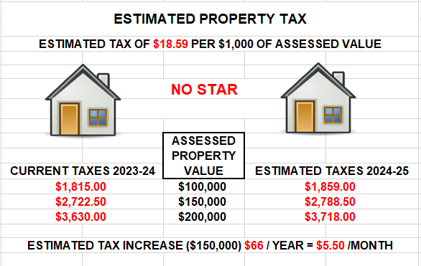
2024-25 Budget Workshop #4
Tax impact real property assessment

Slide 6
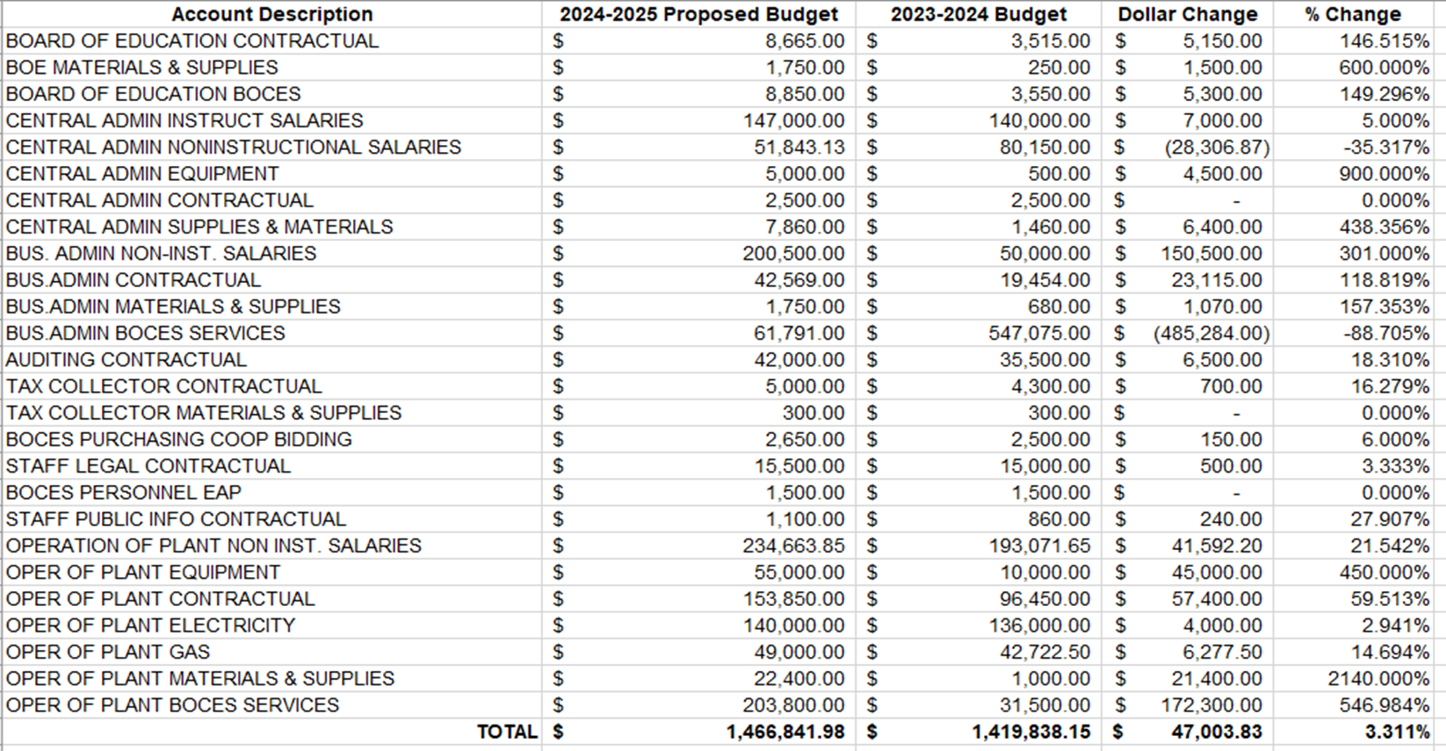
2024-25 Budget Workshop #4
Final Review of 2024-2025 Budget

Slide 7
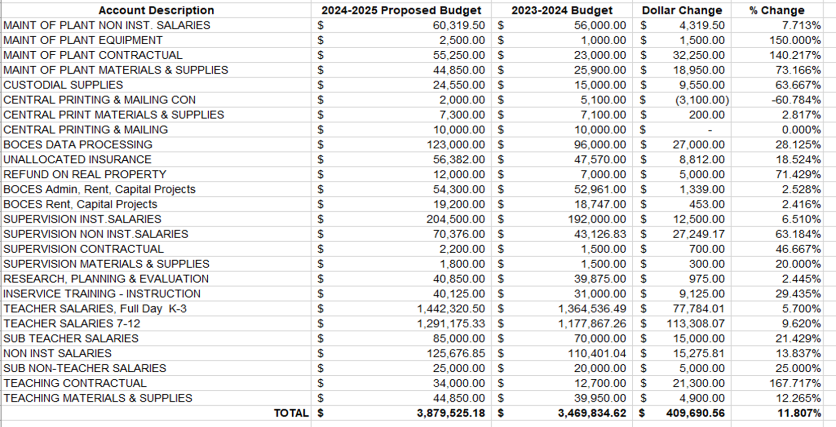
2024-25 Budget Workshop #4
Final Review of 2024-2025 Budget

Slide 8
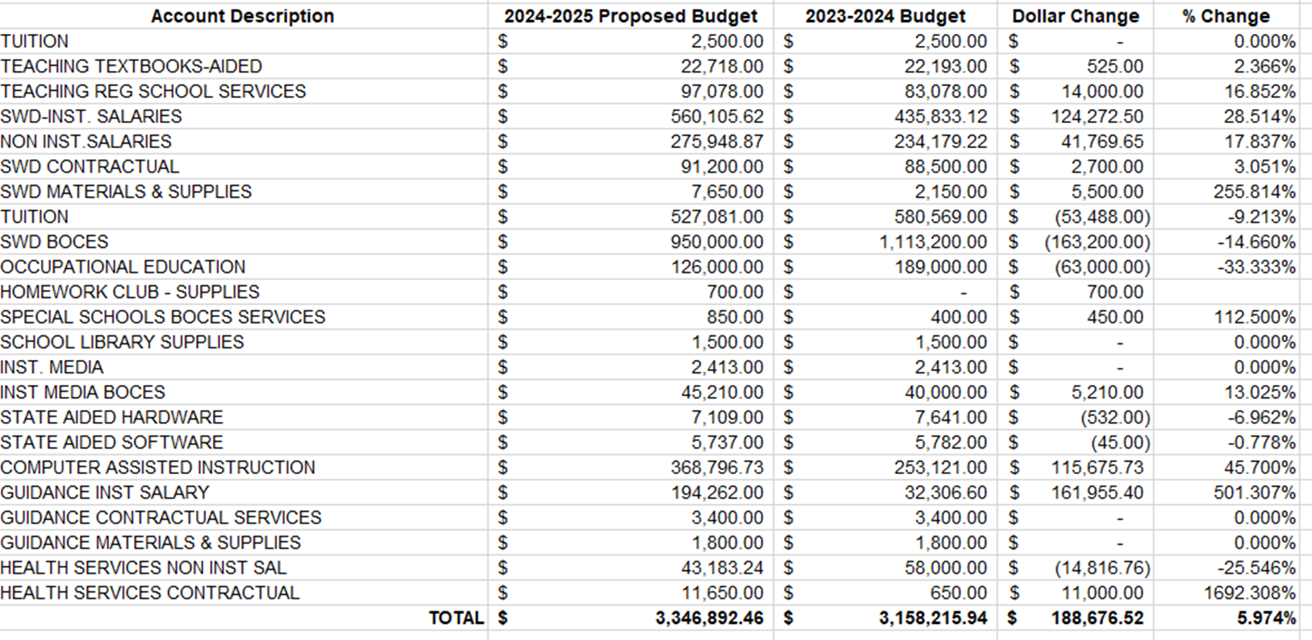
2024-25 Budget Workshop #4
Final Review of 2024-2025 Budget

Slide 9
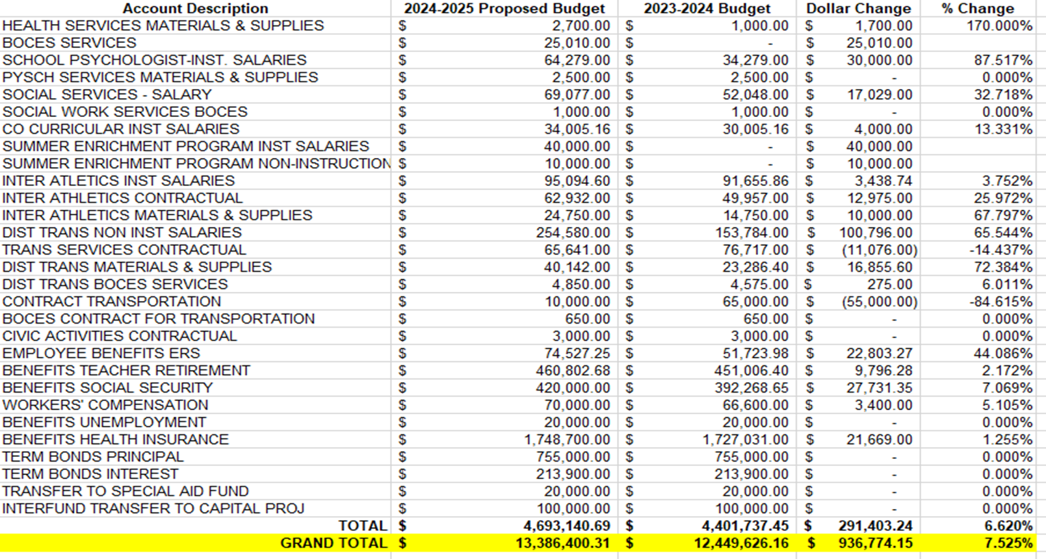
2024-25 Budget Workshop #4
Final Review of 2024-2025 Budget

Slide 10
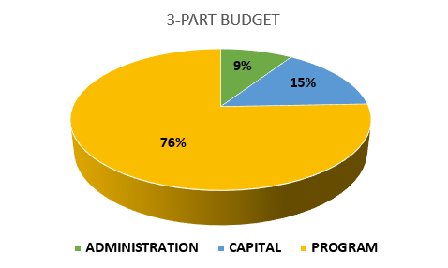
2024-25 Budget Workshop #4
3-part budget

Slide 11
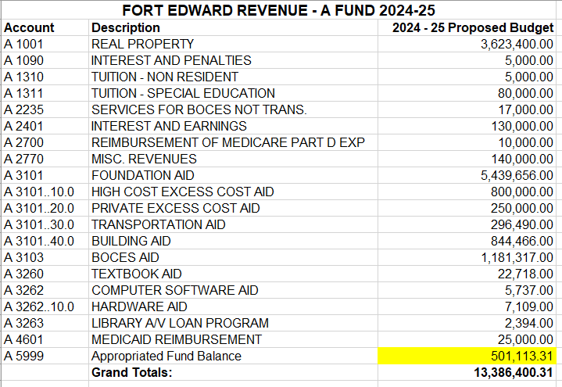
2024-25 Budget Workshop #4
Revenue Update

Slide 12
2024-25 Budget Workshop #4
Fund Balance Projections

Slide 13
2024-25 Budget Workshop #4
QUESTIONS
???

